Slide 1
Bike Share Results
Google Data Analytics Case Study
Grant Cheng

Slide 2
Table of Contents
Questions to Answer
Data Sources
Documentation of Data Processing
Summary of Analysis
Key Findings
Top 3 Recommendations

Slide 3
Questions To Answer
How does the usage of company bikes compare between members and casual riders?
For what reasons are memberships bought?
How do we influence or persuade casual rides to become members using social media?

Slide 4
Data Sources
Data is downloaded from company’s AWS S3 bucket
Data that is analyzed is from the previous 12 months (July 2023-June 2024)
Data downloaded to local machine and is in CSV format

Slide 5
Documentation of Data Processing
The total time of each ride was calculated by Excel’s simple subtraction of end time and start time columns.
Weekday (1 through 7) was determined using Excel’s weekday() formula with 1 being Sunday and 7 being Saturday.
From there, Python code was used to drop rides with empty fields, distance from longitude and latitude is derived via the Haversine formula, total time of each ride was converted to the number of seconds.
Validation strategy was to check if the ride had zero time or same start and finish location.

Slide 6
Summary of Analysis
SQL queries were used to derive statistics of the dataset.
Python libraries (pandas, numpy, matplotlib, seaborn) were used to create additional statistical visualizations
Some key findings are on the next few slides

Slide 7
SQL Queries of Average Ride Time
casual riders
months | avg_ride_seconds
Jul-23 | 1522.121
Aug-23 | 1465.956
Sep-23 | 1417.677
Oct-23 | 1289.701
Nov-23 | 1073.716
Dec-23 | 999.9914
Jan-24 | 926.7172
Feb-24 | 1185.428
Mar-24 | 1325.986
Apr-24 | 1492.75
May-24 | 1627.74
Jun-24 | 1582.894
annual members
months | avg_ride_seconds
Jul-23 | 809.9794
Aug-23 | 805.9131
Sep-23 | 767.6857
Oct-23 | 705.0661
Nov-23 | 668.4448
Dec-23 | 652.6668
Jan-24 | 693.9084
Feb-24 | 706.5172
Mar-24 | 689.8511
Apr-24 | 741.5336
May-24 | 804.7638
Jun-24 | 820.8744

Slide 8
SQL Queries of Weekday Frequency
casual riders
day_of_week | percentage_of_total
1 | 6.28%
2 | 4.11%
3 | 4.07%
4 | 4.17%
5 | 4.28%
6 | 5%
7 | 7.29%
annual members
day_of_week | percentage_of_total
1 | 7.34%
2 | 9.24%
3 | 10.23%
4 | 10.48%
5 | 10.32%
6 | 9.01%
7 | 8.17%

Slide 9
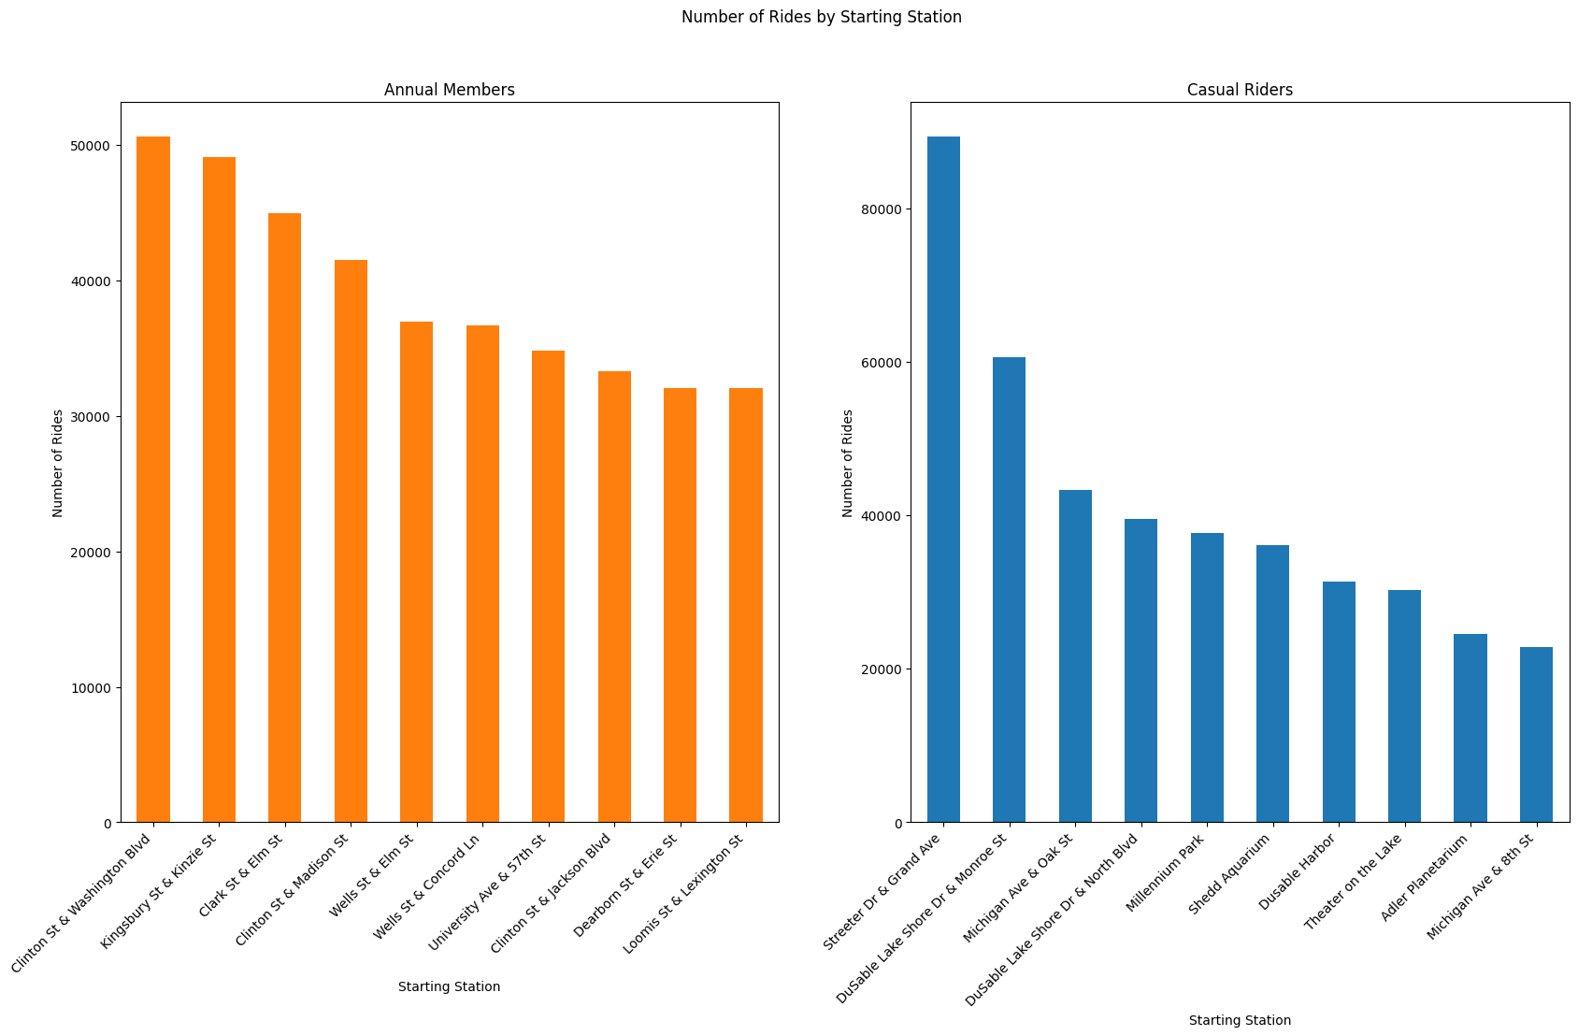
Python Analysis
 | Top 3 Starting Stations
Rank | Members
1 | Clinton St & Washington Blvd
2 | Kingsbury St & Kinzie St
3 | Clark St & Elm St
Rank | Casuals
1 | Streeter Dr & Grand Ave
2 | DuSable Lake Shore Dr & Monroe St
3 | Michigan Ave & Oak St

Slide 10
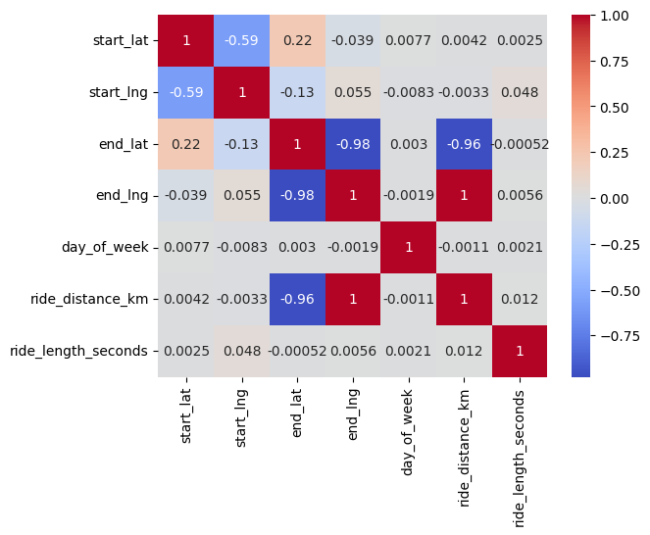
Correlation Heatmap of Numerical Variables

Slide 11
Key Findings
Members are more likely to ride less hours throughout the year than casual riders, but are more consistent in duration
Members are more likely to ride on weekdays (Mondays through Fridays) than on weekends
Members are more likely to start at the Clinton St & Washington Blvd, Kingsbury St & Kinzie St, or Clark St & Elm St stations

Slide 12
Top 3 Recommendations
Target high-wealth, busy, active people.
Target people with more spare time on weekdays.
Target people who live near the top 3 starting stations.

Slide 13
Next Steps
Find socioeconomic profiles of members and casual riders
Survey members for psychological and motivational profiles
Develop more analysis techniques for geographical data
Focus on summer months to attract new people to events

